Slide 1
Microsoft Power BI

Slide 2
Using the Power BI Export API to Generate PDF and Image Files
Ted Pattison
Principal Program Manager
Power BI Customer Advisory Team (PBICAT)

Slide 3
Welcome to Power BI Dev Camp
Power BI Dev Camp Portal - https://powerbidevcamp.net

Slide 4
ExportReportToFile - Developer Sample #1
https://github.com/PowerBiDevCamp/ExportReportToFile

Slide 5
ExportWithAppOwnsData - Developer Sample #2
https://github.com/PowerBiDevCamp/ExportWithAppOwnsData

Slide 6
Agenda
Introduction to the Power BI Export API
Exporting Power BI Reports
Exporting Paginated Reports
Exporting in App-Owns-Data Scenarios
Exporting Reports using Power Apps

Slide 7
Comparing Power BI Reports to Paginated Reports
Export API supports exporting Power BI Reports and Paginated Reports
Power BI Reports support exporting as PDF, PPTX and PNG
Paginated Reports support many additional output formats
Power BI Report Formats
Paginated Report Formats

Slide 8
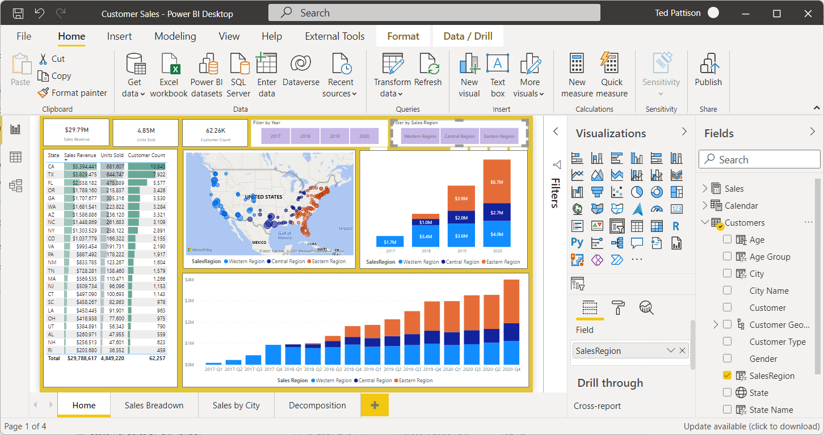
Building/Designing Power BI Reports for Export
Power BI reports created with Power BI Desktop
Reports can be designed with rich interactive UI behavior
Export process based on capturing image as screenshot
Export process can only capture what you can see (retro acronym: WYSIWUG)
Export process cannot handle tables or matrices with scrollbars

Slide 9
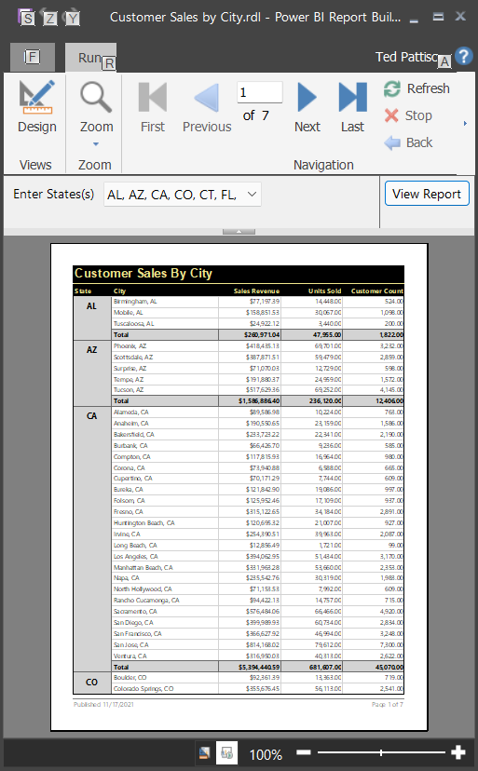
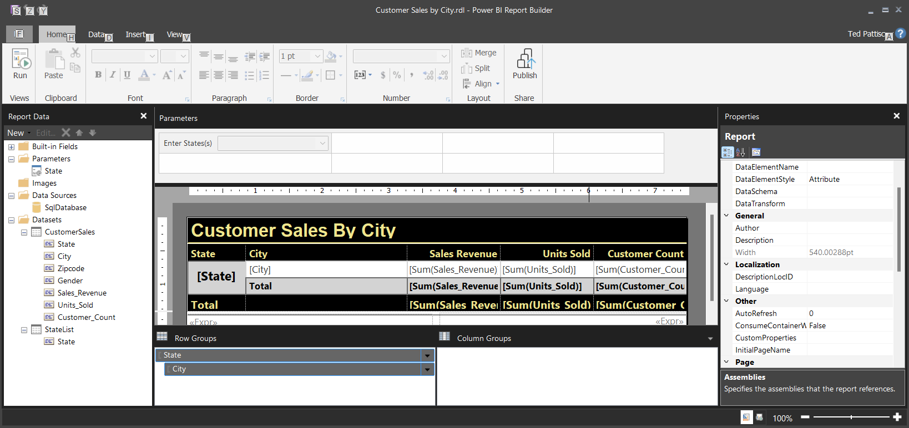
Building/Designing Paginated Reports for Export
Paginated reports created with Power BI Report Builder
Report Builder design experience focused on the printed page or PDF file generation
Provides ability to include page headers and footers
Provides banded report design experience with totals and subtotals
Paginated reports can be designed with parameters
preview

Slide 10
Learn to Build Paginated Reports for Power BI
Check out the Power BI Paginated Reports in a Day Video Playlist on YouTube
Video series with 25 individual lessons focused on building paginated reports for Power BI
Explains how to get started with Power BI Report Builder
Explains which datasources are supported for paginated reports in Power BI
Explains how to design paginated reports with parameters
Playlist: https://www.youtube.com/playlist?list=PL1N57mwBHtN1icIhpjQOaRL8r9G-wytpT

Slide 11
Tenant-Level Admin Settings for Enabling Export API
Before we get started with the Export API…
Ensure tenant-level settings are enabled to allow for export of various file formats

Slide 12
There are three API calls required to export a report
ExportToFileInGroup
Starts asynchronous export job
Returns an Export object with the ExportID
GetExportToFileStatusInGroup
Call requires passing ExportID to return updated export object
Export object tracks Status with values of NotStarted, Running, Succeeded and Failed
Export object also tracks PercentComplete, ReportName, ResourceLocation, ResourceFileExtension,
GetFileOfExportToFileInGroup
Returns a file stream for image file from successfully-completed export job

Slide 13
Exporting a Report with the API - Play by Play
Custom Application
Power BI REST API
ExportToFileInGroup - https://api.powerbi.com/v1.0/myorg/groups/{WorkspaceId}/reports/{ReportId}/ExportTo
async export job
started
GetExportToFileStatusInGroup
async
export job completed
GetExportToFileStatusInGroup
Exported
File
Exported
File
GetFileOfExportToFileInGroup

Slide 14
C# Starter Code for Exporting a Report
Create ExportReportRequest object
Call ExportToFileInGroup
Call GetExportToFileStatusInGroup
Call GetFileOfExportToFileInGroup

Slide 15
Sample Application Demonstrating Export API
A simple C# console application to demonstrate export API usage
Application demonstrates exporting reports using Power BI .NET SDK
Code which calls Export API is in class named PowerBIExportManager

Slide 16
Agenda
Introduction to the Power BI Export API
Exporting Power BI Reports
Exporting Paginated Reports
Exporting in App-Owns-Data Scenarios
Exporting Reports using Power Apps

Slide 17
Exporting Power BI Reports
ExportReportRequest contains PowerBIReportExportConfiguration property
Controls whether to include hidden pages
Allows caller to apply filtering during export process
Allows caller to apply a bookmark or bookmark state during export process
Allows caller control to embed entire report, a single page or a single visual
Export configuration data passed to ExportToFileInGroup API as JSON in request body

Slide 18
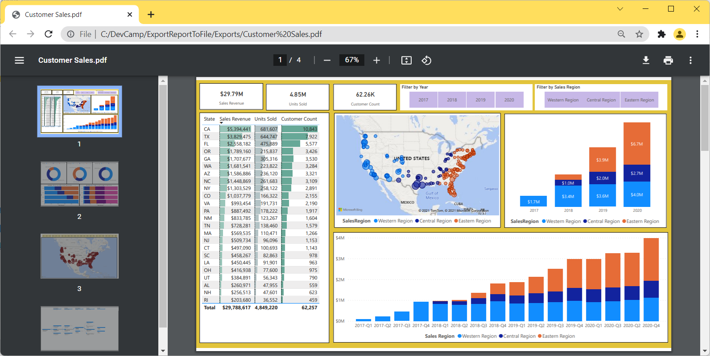
Export Power BI Report as PDF File
Power BI Reports can be exported as PDF file
Each report page is added a screenshot on its own page in PDF
You can choose to include or not to include hidden pages

Slide 19
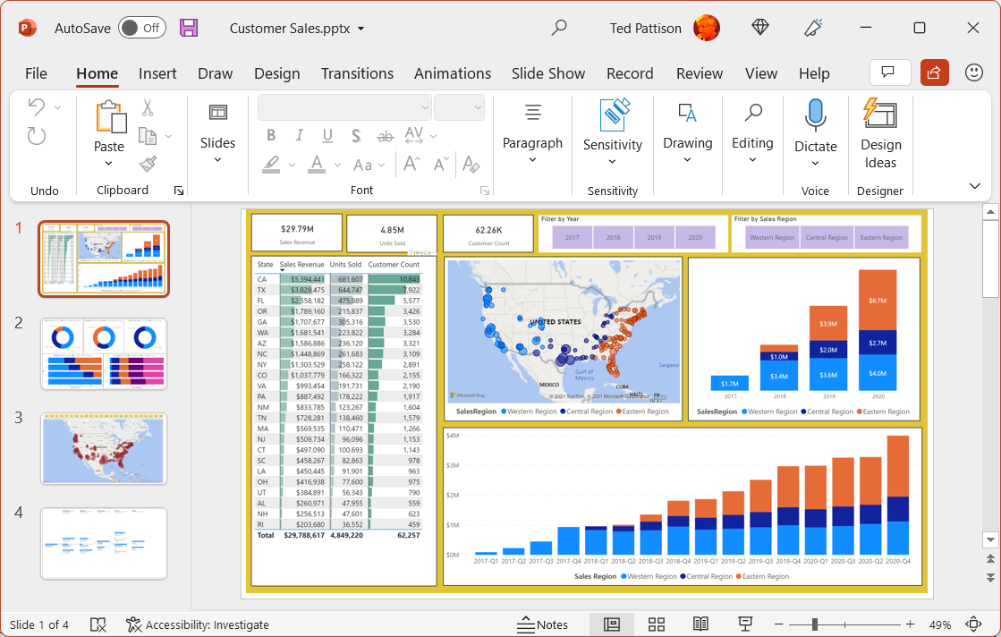
Export Power BI Report as PPTX File
Power BI Reports can be exported as PowerPoint file in PPTX format
Each report page is added a screenshot on its own slide
You can choose to include or not to include hidden pages

Slide 20
Exporting Power BI Report in PNG Format
Power BI report pages can be exported as PNG file
Each report page is generated as single PNG file
Export job with multiple pages returned as ZIP archive with PNGs inside
Customer Sales.zip

Slide 21
Exporting Power BI Report with Applied Filters
Power BI reports can be exported with filtering
Filter values must be passed a single string
Filter string can contain multiple conditions combine with and or or

Slide 22
Exporting Power BI Report using Bookmark Name
Bookmarks defined in report can be applied in export job
Bookmark name is not the friendly display name but internal name known as bookmarkGuid
Bookmark name can be found in bookmarkGuid query string parameter
Example - /?bookmarkGuid=Bookmarkda06dbe08e357b8c1621
Copy bookmarkGuid from end of URL

Slide 23
Exporting Individual Pages and Visuals
You can export a single report page
You must know the page name
You can export a single visual from a report page
You must know the page name and the visual name

Slide 24
Limitation of Exporting Power BI Reports (Gen2)
Number of exports is limited to 50 report pages per minute per capacity
Example – exporting 10 reports with 5 pages each = 50 report pages
Unlike Gen1, there’s no maximum concurrent report pages limitation in Gen2
Power BI visuals listed below are not supported
R visuals
PowerApps
Python visuals
Power Automate
Paginated report visual
Visio
Uncertified custom visuals (this restriction will be eliminated in 2022)

Slide 25
Agenda
Introduction to the Power BI Export API
Exporting Power BI Reports
Exporting Paginated Reports
Exporting in App-Owns-Data Scenarios
Exporting Reports using Power Apps

Slide 26
Exporting Paginated Reports
ExportReportRequest contains PaginatedReportExportConfiguration property
Allows caller to include format settings
Allows caller to pass parameters defined in paginated report
Allows caller to pass user identity for row-level security

Slide 27
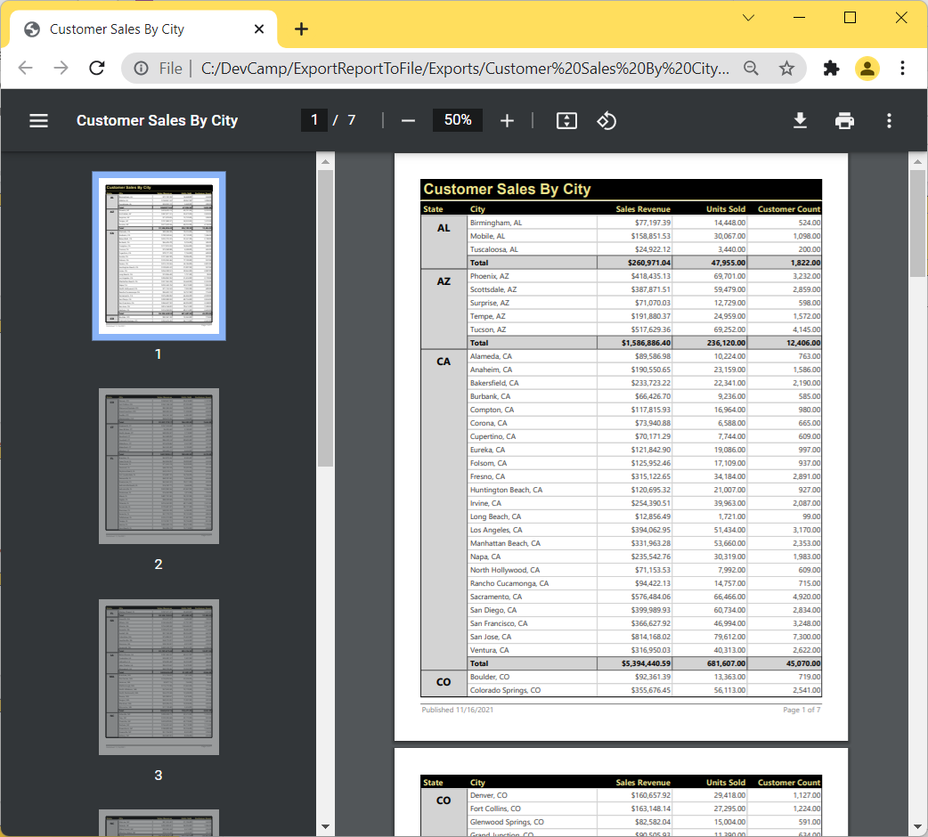
Exporting Paginated Report as PDF File
Paginated reports can be exported as PDF file
Best way to create multipage report with totals, header, footers, etc.
Export API supports exporting paginated report to accessible PDF format

Slide 28
Exporting Paginated Report with Parameters
Paginated reports can be designed with parameters
Parameters commonly used for filtering
Parameters can be used for other creative purposes
Parameters can be passed when exporting paginated report

Slide 29
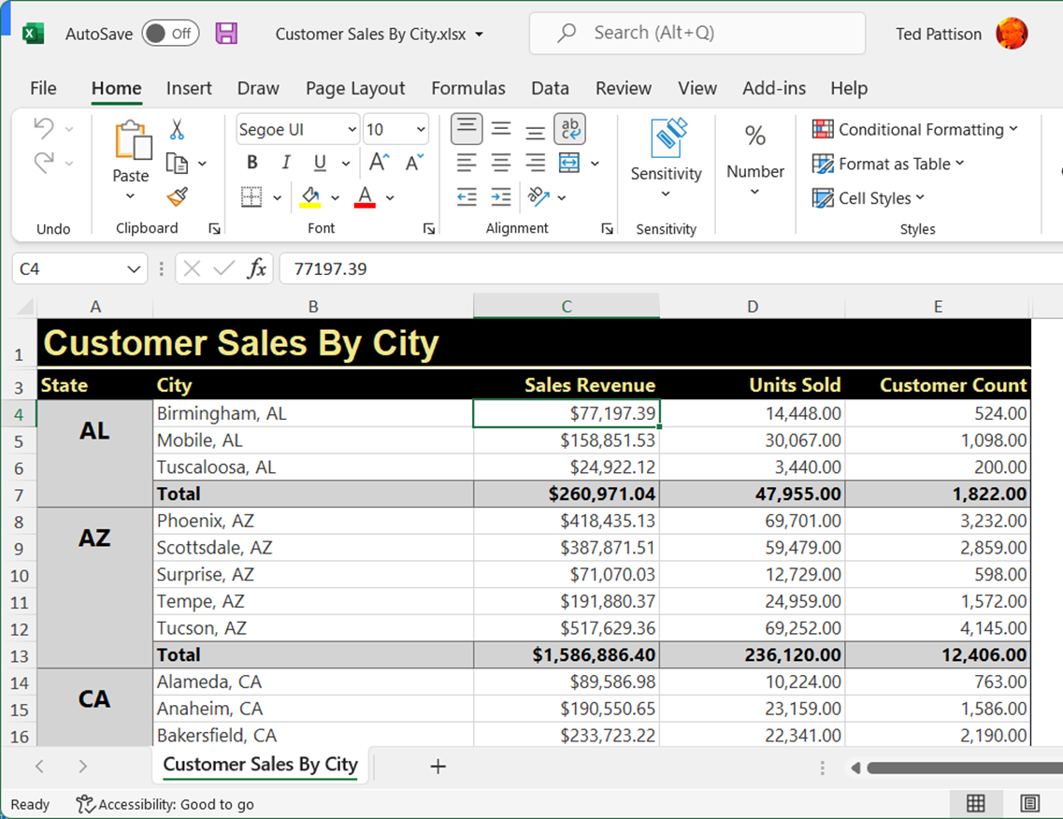
Exporting Paginated Report to XLSX and CSV Files
Paginated reports can be exported in XSLX and CSV formats
Allows users to load and analyze data using Microsoft Excel

Slide 30
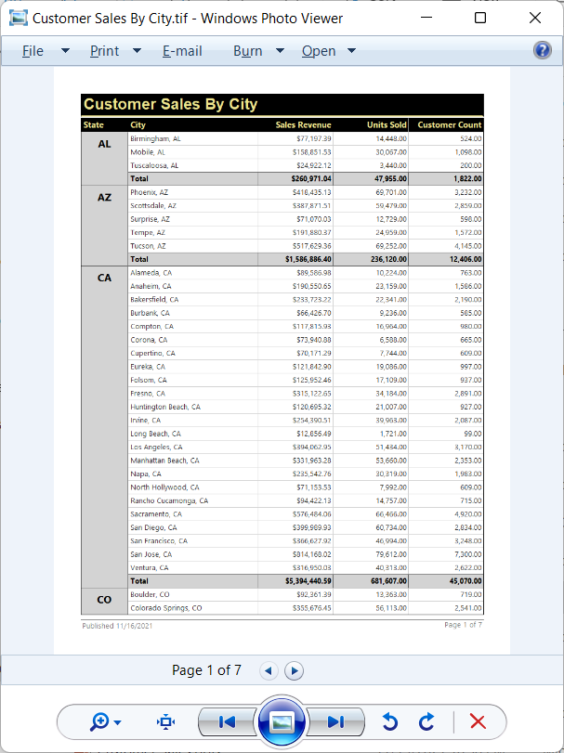
Exporting Paginated Reports Using Image File Formats
Paginated reports support format setting of Image
Required for exporting image files in formats of TIF, EMF, BMP, JPG, GIF and PNG
FormatSetting named OutputFormat used to specify file format

Slide 31
Paginated Reports Limitations
Number of paginated report exports is limited to 50 reports per minute per capacity.
Export of single report limited to 60 minutes due to life of the access token
Exporting paginated report bound to PBI dataset not supported for service principals
Exporting paginated report with effective identity requires existing user in AAD tenant

Slide 32
Agenda
Introduction to the Power BI Export API
Exporting Power BI Reports
Exporting Paginated Reports
Exporting in App-Owns-Data Scenarios
Exporting Reports using Power Apps

Slide 33
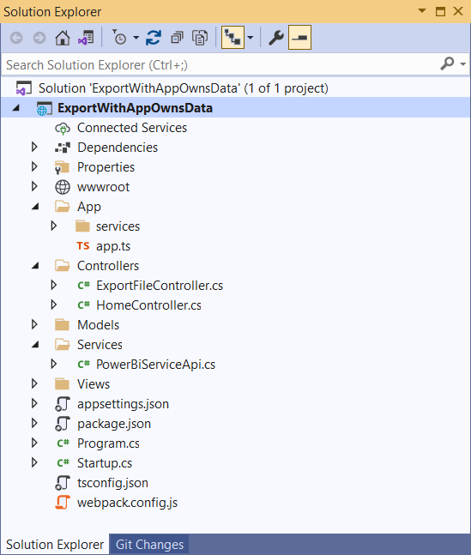
Developer Sample - ExportWithAppOwnsData
Sample application demonstrates exporting reports with App-Owns-Data
All Power BI REST API calls executed as service principal
Solution architecture requires client call from browser to custom Web API
Custom Web API calls Power BI Export API and returns file back to browser

Slide 34
Capturing Bookmark State and Active Page Name
Custom bookmarks can be capture using Power BI JavaScript API
Bookmark can be captured dynamically using bookmarkManager.capture()
Captured bookmark hold current filter settings applied by user
Custom bookmark state can be used to retain filter setting during export job

Slide 35
App-Owns-Data Export Sample Architecture
JavaScript Code
running in Browser
C# code running in
Custom Web API
Power BI REST API
ExportFile – Custom Web API
synchronous
blocking call
ExportToFileInGroup
asynchronous
non blocking call
GetExportToFileStatusInGroup
Exported
File
Exported
File
Exported
File
ExportFile API Response
GetFileOfExportToFileInGroup

Slide 36
Exporting a Single Page using Bookmark State
Custom bookmarks make it possible to retain current slicer settings
Allows for submitting exporting job with same filtering in current report or page
JavaScript
running in Browser
Custom Web API
Power BI REST API

Slide 37
Exporting a Single Visual using Slicer Filtering
ExportWithAppOwnsData demonstrates custom menu to export single visual
Custom menus added in embed configuration
Names of page and visual can be captured in event handler for menu
Current slicer filtering can be captured in event handler for menu
JavaScript
running in Browser
Custom Web API
Power BI REST API

Slide 38
App-Owns-Data Embedding with Paginated Reports
Embedded paginated reports display Export menu
User can use Export menu to download export by hand in any available format
No need to include custom web API as with exporting Power BI report with App-Owns-Data

Slide 39

Building a Turducken with the Paginated Report Visual
Paginated reports can be nested in Power BI report using Paginated Report visual
Embed token must include report ID for host report and for paginated report
Power BI Report
what is a turducken?
Filtering with Power BI Report Slicers
Paginated Report Visual
turkey
Paginated Report Visual
Paginated Report
Paginated Report
chicken
duck
Power BI Dataset

Slide 40
Embedding Reports with Paginated Report Visual
Nested paginated report provides user with Export menu
Slicer filter settings on Power BI report can be passed as parameters values
Export menu will export paginated report with current parameter settings

Slide 41
Passing parameters to the Paginated Report Visual
Paginated Report visual allows parameter configuration
Columns passed as parameters must be added to Parameters data role

Slide 42
Enabling the Auto-apply filters Setting
Forces paginated report to automatically refresh whenever parameters are updated

Slide 43
Agenda
Introduction to the Power BI Export API
Exporting Power BI Reports
Exporting Paginated Reports
Exporting in App-Owns-Data Scenarios
Exporting Reports using Power Apps

Slide 44
Export To File for Power BI Report Action
Power Automate provides built-in actions –
Export To File for Power BI Report
Export To File for Paginated Report
Actions enable exporting reports and saving image file to SharePoint, Azure, etc.

Slide 45
Calling the Power BI REST API from Power Apps
Sample Power Apps solution for exporting Power BI reports
Demonstrates exporting report image files to SharePoint document library
Custom Connector
Power BI REST API
Canvas App
Get Groups
Get Reports in Group
Get Pages in Group
Export To File for
Power BI Report Action
Flow
Export to File in Group

Slide 46
Demo Building a Canvas App to Export Power BI Report and Paginated Report

Slide 47
Summary
Introduction to the Power BI Export API
Exporting Power BI Reports
Exporting Paginated Reports
Exporting in App-Owns-Data Scenarios
Exporting Reports using Power Apps

Slide 48
Microsoft Power BI
Questions?

